Slide 1

Bird classification with Classificationbox
And Home-Assistant
Dr Robin Cole

Slide 2
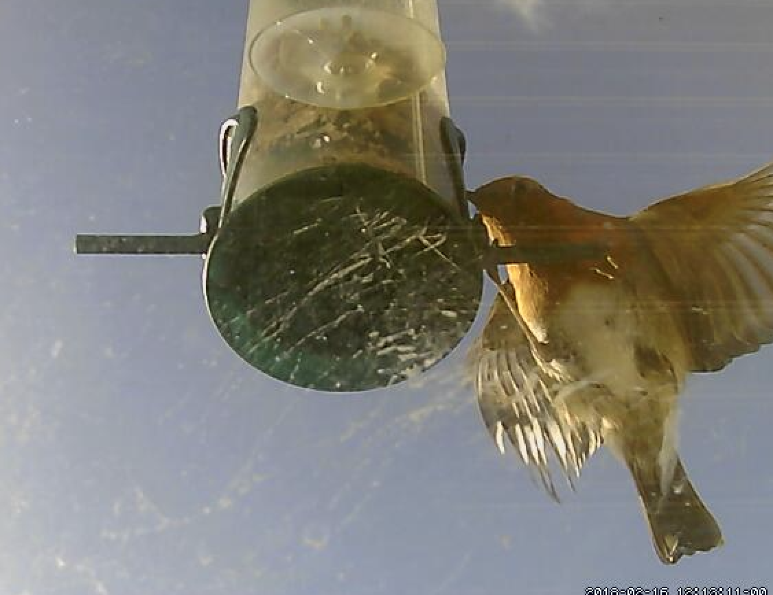
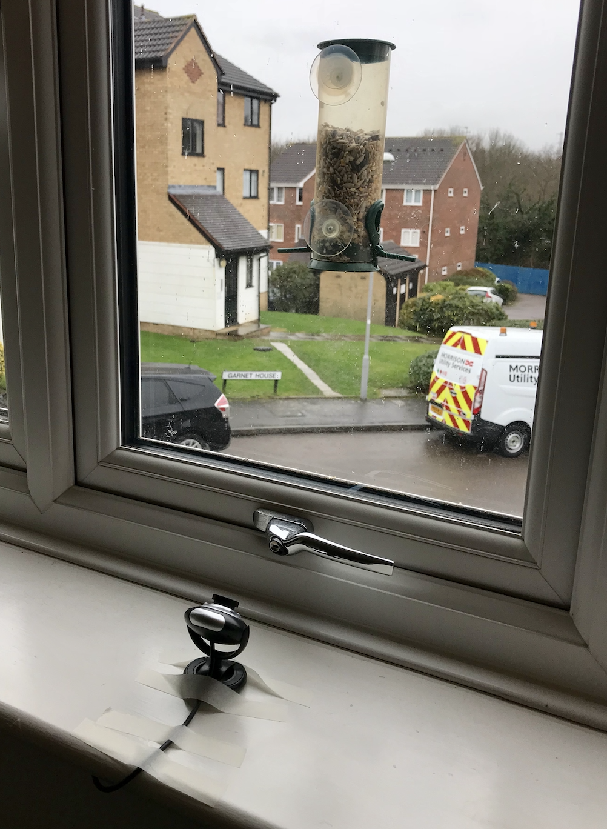
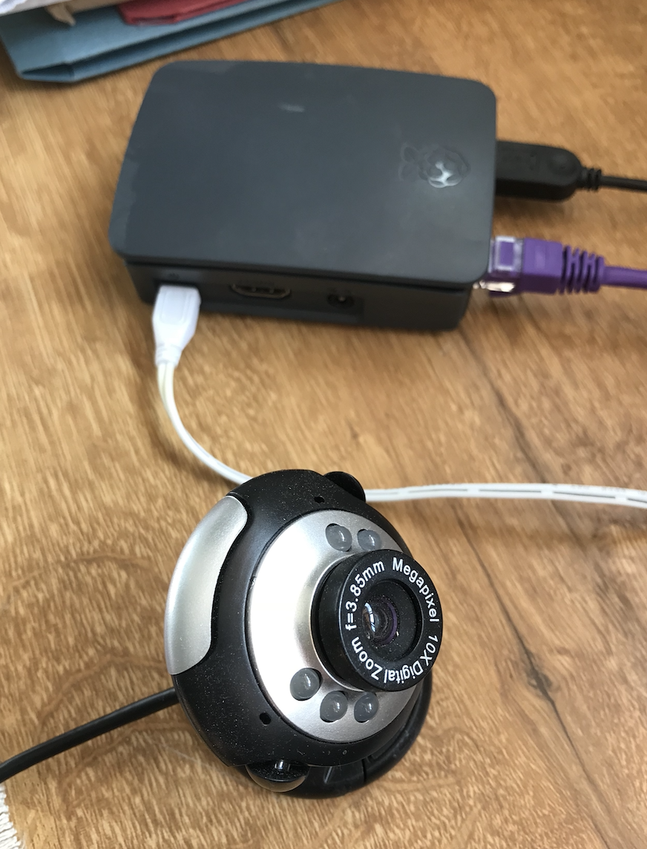
Bird identification
Project goal: automatically photograph and identify birds visiting my bird feeder, gather data that I can share with birdlife study https://www.rspb.org.uk/..birdwatch
Motion triggered £10 camera & Pi3 Home-Assistant

Slide 3

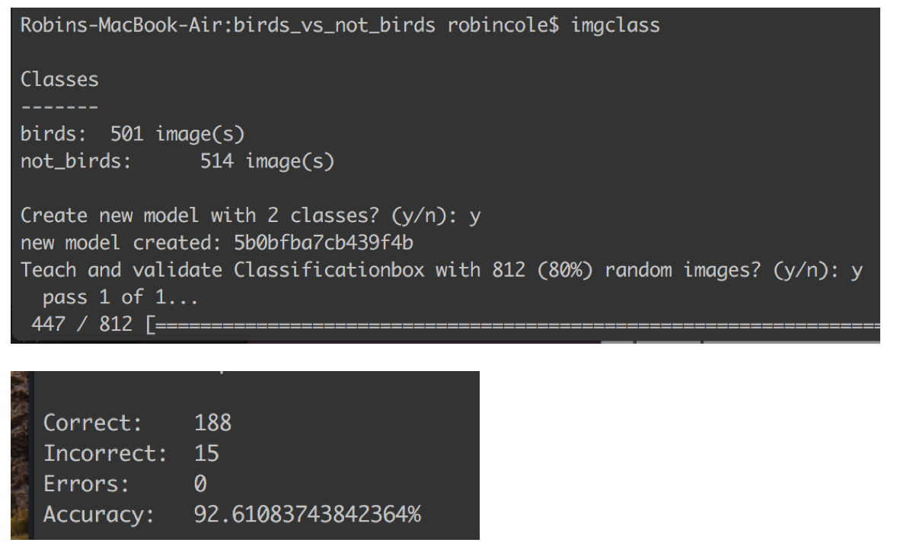
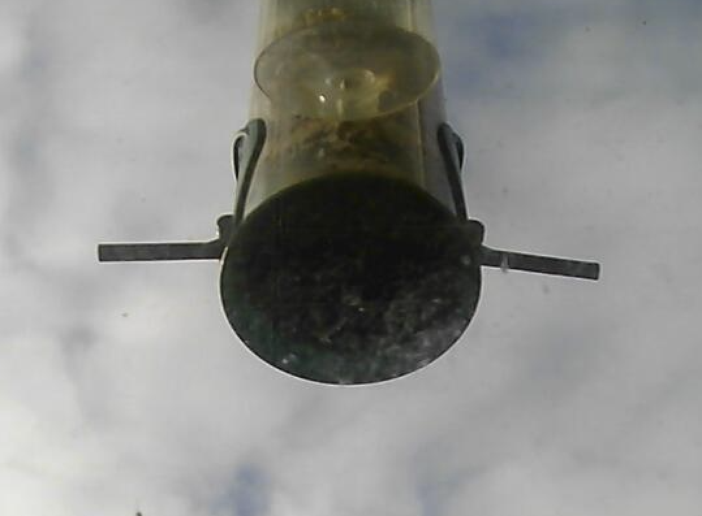
Task 1: identifying bird/not-bird images
For a simple to use classifier I used https://machinebox.io/docs/classificationbox
Bird
Trained classifier with 1000 images
bird/not-bird discrimination with ~ 90% accuracy, beats my expectations!
Not-bird

Slide 4
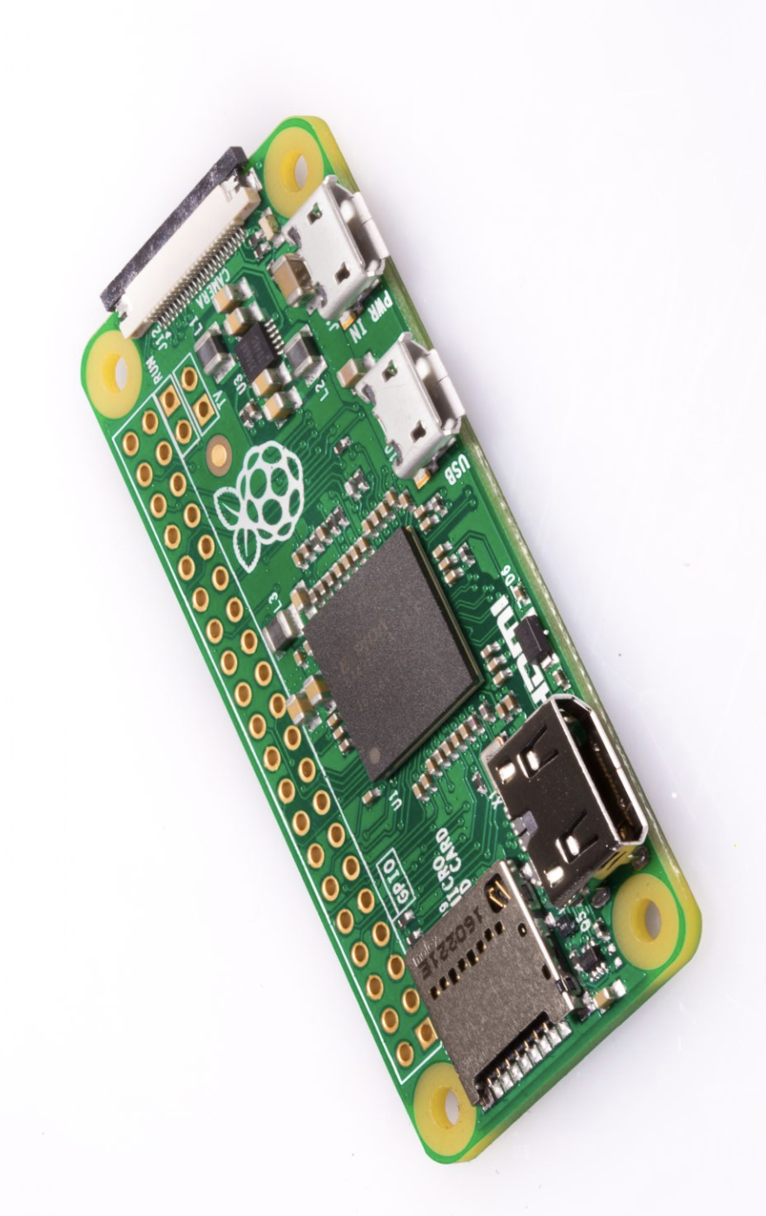
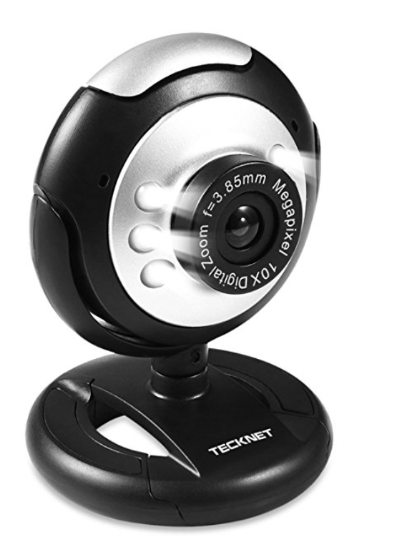


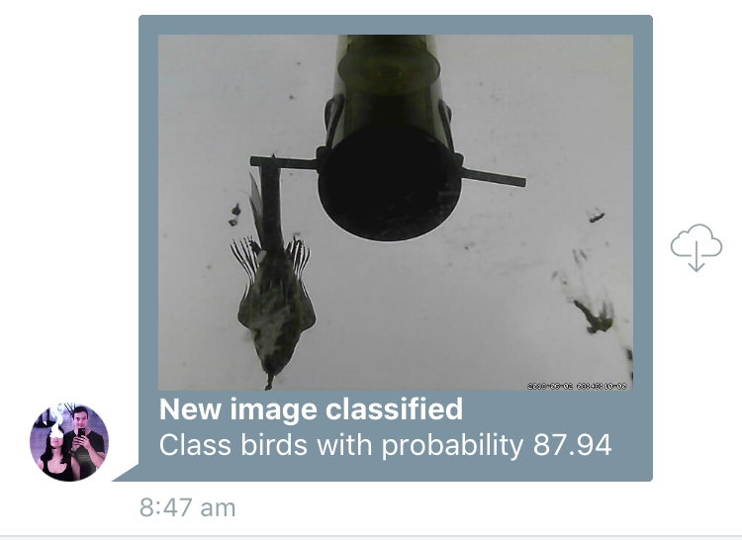

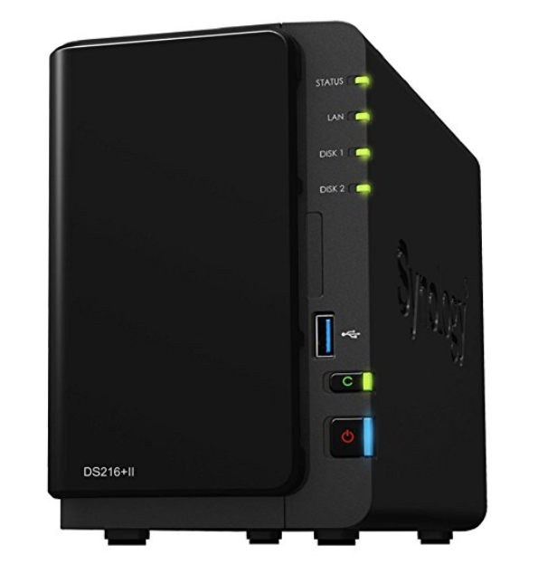

Task 2: Automating identification
Home-Assistant
on Rpi
Motion triggered
USB Image capture
If bird
Classificationbox
In Docker on local server
Notification with image
https://github.com/robmarkcole/HASS-Machinebox-Classificationbox

Slide 5
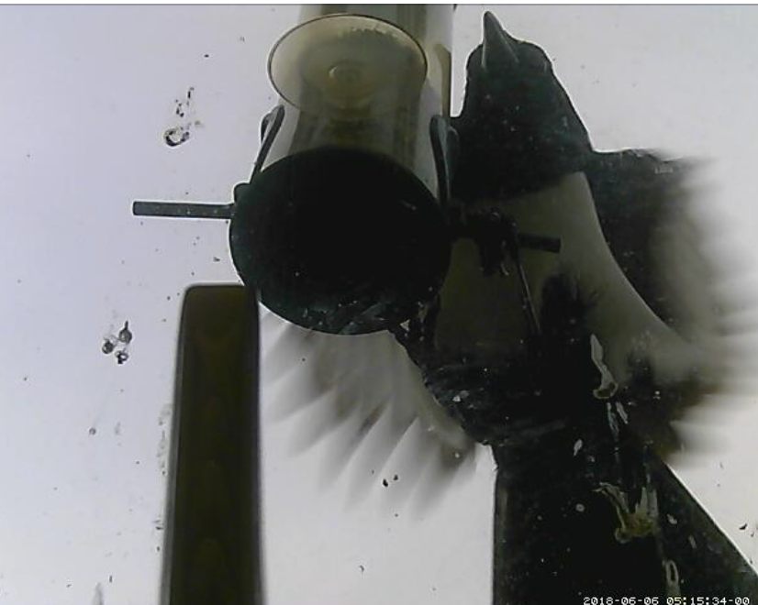
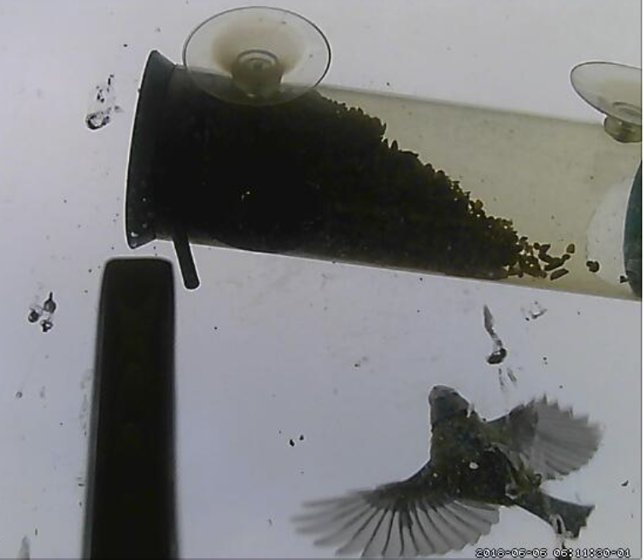
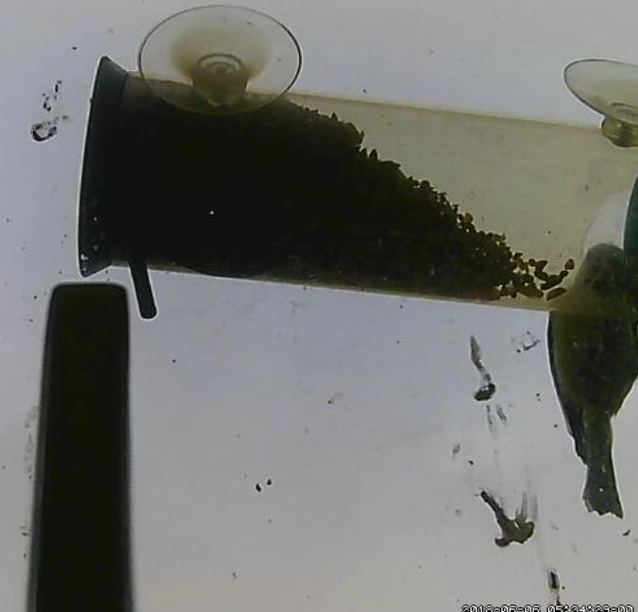
Next steps:
Experiment with curating the images used in training to improve accuracy
Classify birds by species
Contribute data to Birdwatch survey
Add Classificationbox to Home-Assistant
Share classifiers and know-how with less technical bird-fanciers
Make bird-feeder magpie proof!
Thank you!

Slide 6
Motion triggered image saved
Display motion triggered image
Classify motion triggered image
Send image notification

Slide 7
